Slide 1
Overview of Query Evaluation
Chapter 12
Notes:
1
The slides for this text are organized into chapters. This lecture covers Chapter 13.
Chapter 1: Introduction to Database Systems
Chapter 2: The Entity-Relationship Model
Chapter 3: The Relational Model
Chapter 4 (Part A): Relational Algebra
Chapter 4 (Part B): Relational Calculus
Chapter 5: SQL: Queries, Programming, Triggers
Chapter 6: Query-by-Example (QBE)
Chapter 7: Storing Data: Disks and Files
Chapter 8: File Organizations and Indexing
Chapter 9: Tree-Structured Indexing
Chapter 10: Hash-Based Indexing
Chapter 11: External Sorting
Chapter 12 (Part A): Evaluation of Relational Operators
Chapter 12 (Part B): Evaluation of Relational Operators: Other Techniques
Chapter 13: Introduction to Query Optimization
Chapter 14: A Typical Relational Optimizer
Chapter 15: Schema Refinement and Normal Forms
Chapter 16 (Part A): Physical Database Design
Chapter 16 (Part B): Database Tuning
Chapter 17: Security
Chapter 18: Transaction Management Overview
Chapter 19: Concurrency Control
Chapter 20: Crash Recovery
Chapter 21: Parallel and Distributed Databases
Chapter 22: Internet Databases
Chapter 23: Decision Support
Chapter 24: Data Mining
Chapter 25: Object-Database Systems
Chapter 26: Spatial Data Management
Chapter 27: Deductive Databases
Chapter 28: Additional Topics

Slide 2
Objectives
Preliminaries:
  Core query processing techniques
  Catalog
  Access paths to data
  Index matching
Summary of query processing algorithms
  Selection
  Projection
  Join
Introduction to query optimization
  Query plans
  Alternative query plans
Notes:
2

Slide 3
Overview of Query Evaluation
Evaluating SQL queries:
    parsed,
    then translated into an extended form of relational algebra,
    which is transformed into an evaluation plan.
Plan: Tree of R.A. ops, with algorithm choice for each op.
  An operator computes its output using the algorithms chosen.
Main issues in evaluating (optimizing) a given query:
  Enumerating alternative plans
  Estimating the costs of the plans and choosing cheapest one
Ideally: Find best plan. Practically: Avoid worst plans!
We will study the System R approach.
Notes:
2

Slide 4
Techniques Used in Query Evaluation
Algorithms for evaluating relational operators use some simple techniques extensively:
  Indexing: Using WHERE conditions to retrieve small sets of tuples (selections, joins)
  Iteration: Examining all tuples in a relation instance one after the other; i.e., scaning all tuples, even if there is an index. (And sometimes, we can scan the data entries in an index instead of the table itself.)
  Partitioning: Grouping the set of input tuples in smaller sets (by using sorting or hashing). This way, we can replace an expensive operation by similar operations on smaller inputs.

Slide 5
Statistics and Catalogs
The evaluator needs info about the relations and indexes involved. This info is contained in Catalogs:
  for each relation: # tuples (NTuples) and # pages (NPages);
  for each index: # distinct key values (NKeys) and Npages;
  for each tree index: index height, low/high key values (Low/High).
Catalogs updated periodically.
  Updating whenever data changes is too expensive; lots of approximation anyway, so slight inconsistency tolerated.
More detailed information (e.g., histograms of the values in some field) is sometimes stored.
Notes:
8

Slide 6
Access Paths and Matching Indexes
An access path is a method of retrieving tuples:
  File scan, or index that matches a selection (in the query)
A tree index matches (a conjunction of) terms that involve only attributes in a prefix of the search key.
  E.g., Tree index on <a, b, c> matches the selection a=5 AND b=3, and a=5 AND b>6, but not b=3.
  Matched conjuncts are called primary conjuncts.
A hash index matches (a conjunction of) terms that have a term attribute = value for every attribute in the search key of the index.
  E.g., Hash index on <a, b, c> matches a=5 AND b=3 AND c=5; but it does not match b=3, or a=5 AND b=3, or a>5 AND b=3 AND c=5.
Notes:
13

Slide 7
Examples of Matching Indexes
Tree index with key <sal,age>
  Match:
    age=12 AND sal=20
    age>11 AND sal=20
    sal=75
  No match:
    sal =75
Hash index
  Match:
    Sal=75 AND age =13
    age=11 AND sal =90
  No match:
    sal=75
    age=12
    age>11 AND sal=20
Examples of composite key
indexes using lexicographic order.
11,80
11
12,10
12
12,20
name
age
sal
12
13,75
bob
12
10
13
<age, sal>
cal
11
80
<age>
joe
12
20
10,12
sue
13
75
10
20,12
Data records
sorted by name
20
75,13
75
80,11
80
<sal, age>
<sal>
Data entries in index
sorted by <sal,age>
Data entries
sorted by <sal>
Notes:
13

Slide 8
A Note on Complex Selections
(day<8/9/94 AND rname=‘Paul’) OR bid=5 OR sid=3
Selection conditions are first converted to conjunctive normal form (CNF):
(day<8/9/94 OR bid=5 OR sid=3 ) AND (rname=‘Paul’ OR bid=5 OR sid=3)
We only discuss case with no ORs; see text if you are curious about the general case.
Notes:
13

Slide 9
Algorithm for Selection
Consider day<8/9/94 AND bid=5 AND sid=3.
  A B+ tree index on day can be used; then, bid=5 and sid=3 must be checked for each retrieved tuple.
  Similarly, a hash index on <bid, sid> could be used; day<8/9/94 must then be checked.
Find the most selective access path, retrieve tuples using it, and apply any remaining (selection) terms that don’t match the index:
  Most selective access path: An index or file scan that we estimate will require the fewest page I/Os.
  Terms that match this index reduce the number of tuples retrieved; other terms are used to discard some retrieved tuples, but do not affect number of tuples/pages fetched.
Notes:
14

Slide 10
Using an Index for Selections
Cost depends on #qualifying tuples, and clustering.
  Cost of finding qualifying data entries (typically small) plus cost of retrieving records (could be large w/o clustering).
  Example: assume a relation Reserves with 1000 pages containing 100 tuples each; and assume uniform distribution of names.
  In query below, about 10% of tuples qualify. With a clustered index, cost is little more than 100 I/Os; if unclustered, upto 10000 I/Os!
SELECT *
FROM Reserves R
WHERE R.rname < ‘C%’
Notes:
12

Slide 11
Algorithm for Projection
SELECT DISTINCT
R.sid, R.bid
FROM Reserves R
Algorithm:
  Take Reserves and keep only R.sid and R.bid.
  Then remove duplicates.
    Approach: Sort on <sid, bid> and remove duplicates (Can optimize this by dropping unwanted information while sorting.)
    Approach: Hash on <sid, bid> to create partitions. Load partitions into memory one at a time, build in-memory hash structure, and eliminate duplicates.
The expensive part is removing duplicates.
  SQL systems don’t remove duplicates unless the keyword DISTINCT is specified in a query.
If there is an index with both R.sid and R.bid in the search key, may be cheaper to sort data entries!
Notes:
16

Slide 12
Join: Index Nested Loops
foreach tuple r in R do
foreach tuple s in S where r_{i} == s_{j} do
add <r, s> to result
R is the outer relation; S is the inner relation.
If there is an index on the join column of one relation (say S), can make it the inner relation and exploit the index.
For each R tuple, cost of probing S index is about 1.2 for hash index, 2-4 for B+ tree. Cost of then finding S tuples (assuming Alt. (2) or (3) for data entries) depends on clustering.

Slide 13
Examples of Index Nested Loops
Assume R has 1000 pages, and S has 500 pages.
Hash-index (Alt. 2) on sid of Sailors (as inner):
  Scan Reserves: 1000 page I/Os, 100*1000 tuples.
  For each Reserves tuple: 1.2 I/Os to get data entry in index, plus 1 I/O to get (the exactly one) matching Sailors tuple. Total: 220,000 I/Os.
Hash-index (Alt. 2) on sid of Reserves (as inner):
  Scan Sailors: 500 page I/Os, 80*500 tuples.
  For each Sailors tuple: 1.2 I/Os to find index page with data entries, plus cost of retrieving matching Reserves tuples. Assuming uniform distribution, 2.5 reservations per sailor (100,000 / 40,000). Cost of retrieving them is 1 or 2.5 I/Os depending on whether the index is clustered.
Notes:
8

Slide 14

Join: Sort-Merge (R S)
i=j
Sort R and S on the join column, then scan them to do a ``merge’’ (on join col.), and output result tuples.
  Advance scan of R until current R-tuple >= current S tuple, then advance scan of S until current S-tuple >= current R tuple; do this until current R tuple = current S tuple.
  At this point, all R tuples with same value in Ri (current R group) and all S tuples with same value in Sj (current S group) match; output <r, s> for all pairs of such tuples.
  Then resume scanning R and S.
R is scanned once; each S group is scanned once per matching R tuple. (Multiple scans of an S group are likely to find needed pages in buffer.)
Notes:
11

Slide 15
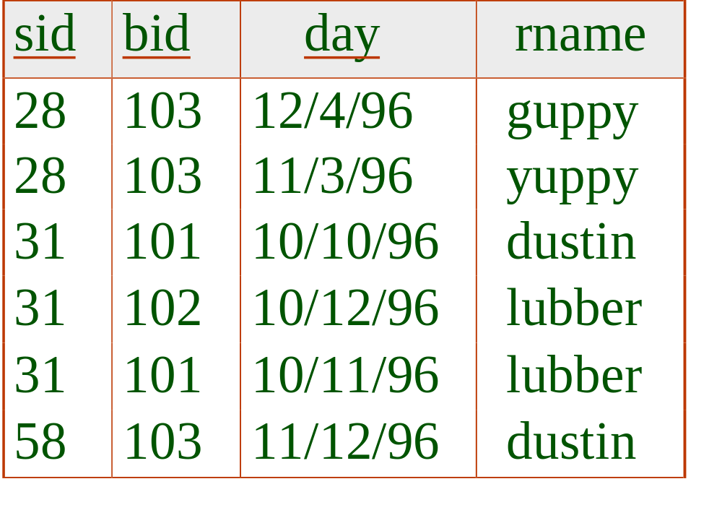
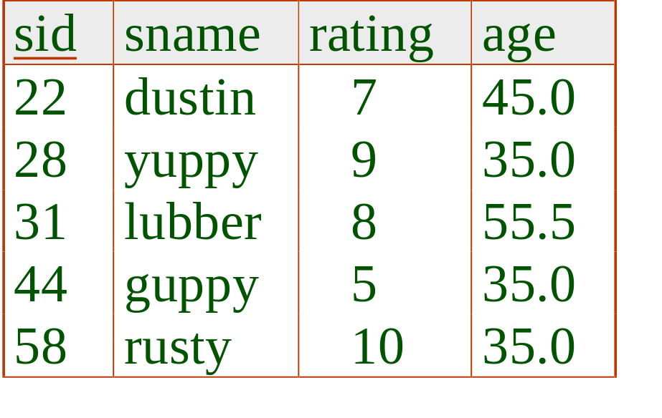
Sort-Merge Join: Example
Algorithm: first sort; then merge on join column.
Cost: M log M + N log N + (M+N)
  The cost of scanning, M+N, could be M*N (very unlikely!)
Notes:
12

Slide 16
Highlights of System R Optimizer
Naive idea: Generate all possible query plans and pick the best possible by using heuristics.
Impact:
  Most widely used currently; works well for < 10 joins.
Cost estimation: Approximate art at best.
  Statistics, maintained in system catalogs, used to estimate cost of operations and result sizes.
  Considers combination of CPU and I/O costs.
Plan Space: Too large, must be pruned.
  Only the space of left-deep plans is considered.
    Left-deep plans allow output of each operator to be pipelined into the next operator without storing it in a temporary relation.
  Cartesian products avoided.
Notes:
2

Slide 17
Cost Estimation
For each plan considered, must estimate cost:
  Must estimate cost of each operation in plan tree.
    Depends on input cardinalities.
    In Databases I, we’ve already discussed how to estimate the cost of operations (sequential scan, index scan, joins, etc.)
  Must also estimate size of result for each operation in tree!
    Use information about the input relations.
    For selections and joins, assume independence of predicates.
Notes:
8

Slide 18
Size Estimation and Reduction Factors
SELECT attribute list
FROM relation list
WHERE term1 AND ... AND termk
Consider a query block:
Maximum # tuples in result is the product of the cardinalities of relations in the FROM clause.
Reduction factor (RF) associated with each term reflects the impact of the term in reducing result size.
  Result cardinality = Max # tuples * product of all RF’s.
  Implicit assumption that terms are independent!
  Term col=value has RF 1/NKeys(I), given index I on col
  Term col1=col2 has RF 1/MAX(NKeys(I1), NKeys(I2))
  Term col>value has RF (High(I)-value)/(High(I)-Low(I))
Notes:
9

Slide 19
Schema for Examples
Sailors (sid: integer, sname: string, rating: integer, age: real)
Reserves (sid: integer, bid: integer, day: dates, rname: string)
Reserves:
  Each tuple is 40 bytes long, 100 tuples per page, 1000 pages.
Sailors:
  Each tuple is 50 bytes long, 80 tuples per page, 500 pages.
Notes:
3

Slide 20
Motivating Example
RA Tree:
sname
bid=100
rating > 5
SELECT S.sname
FROM Reserves R, Sailors S
WHERE R.sid=S.sid AND
R.bid=100 AND S.rating>5
sid=sid
Cost: 500+500*1000 I/Os
By no means the worst plan!
Misses several opportunities: selections could have been `pushed’ earlier, no use is made of any available indexes, etc.
Goal of optimization: To find more efficient plans that compute the same answer.
Reserves
Sailors
Plan:
(On-the-fly)
sname
bid=100
rating > 5
(On-the-fly)
(Simple Nested Loops)
sid=sid
Reserves
Sailors
Notes:
4

Slide 21
Alternative Plans 1
(No Indexes)
(On-the-fly)
sname
(Sort-Merge Join)
sid=sid
(Scan;
(Scan;
write to
bid=100
rating > 5
write to
temp T1)
temp T2)
Main difference: push selects.
With 5 buffers, cost of plan:
  Scan Reserves (1000) + write temp T1 (10 pages, if we have 100 boats, uniform distribution).
  Scan Sailors (500) + write temp T2 (250 pages, if we have 10 ratings).
  Sort T1 (2*2*10), sort T2 (2*3*250), merge (10+250)
  Total: 3560 page I/Os.
If we used BNL join, join cost = 10+4*250, total cost = 2770.
If we `push’ projections, T1 has only sid, T2 only sid and sname:
  T1 fits in 3 pages, cost of BNL drops to under 250 pages, total < 2000.
Reserves
Sailors
Notes:
5

Slide 22
Alternative Plans 2
With Indexes
sname
(On-the-fly)
rating > 5
(On-the-fly)
With clustered index on bid of Reserves, we get 100,000/100 = 1000 tuples on 1000/100 = 10 pages.
INL with pipelining (outer is not materialized).
(Index Nested Loops,
sid=sid
with pipelining )
(Use hash
Sailors
index; do
bid=100
not write
result to
temp)
Reserves
  Projecting out unnecessary fields from outer doesn’t help.
Join column sid is a key for Sailors.
  At most one matching tuple, unclustered index on sid OK.
Decision not to push rating>5 before the join is based on
availability of sid index on Sailors.
Cost: Selection of Reserves tuples (10 I/Os); for each,
must get matching Sailors tuple (1000*1.2); total 1210 I/Os.
Notes:
6

Slide 23
Summary
There are several alternative evaluation algorithms for each relational operator.
A query is evaluated by converting it to a tree of operators and evaluating the operators in the tree.
Join operations are of extraordinary importance for the performance of the query evaluator.
Two parts to optimizing a query:
  Consider a set of alternative plans.
    Must prune search space; typically, left-deep plans only.
  Must estimate cost of each plan that is considered.
    Must estimate size of result and cost for each plan node.
    Key issues: Statistics, indexes, operator implementations.
Notes:
19

